Slide 1

REVENUE AND EXPANSION INSIGHTS
TATA Insights and Quants Data Analytics Team

Slide 2
AGENDA
Introduction
Data Processing
Exploratory Analysis
Recommendations

Slide 3
INTRODUCTION
The purpose of this analysis is to show metrics that can evaluate business performance. The analysis can help in giving insights in expansion and showing revenue information of the company.

Slide 4
DATA PROCESSING
The data is processed with Excel by sorting and filtering the data to remove unwanted values that can interfere with the results of our analysis. We removed values from the quantity column that shows negative values. We also removed unit prices that are below $0. We also noticed that there are product information that has question marks on it depicting the information as unknown for those products, so we removed that as well in our analysis. Aside from these corrections, the data is accurate and relevant to answer the business tasks.

Slide 5
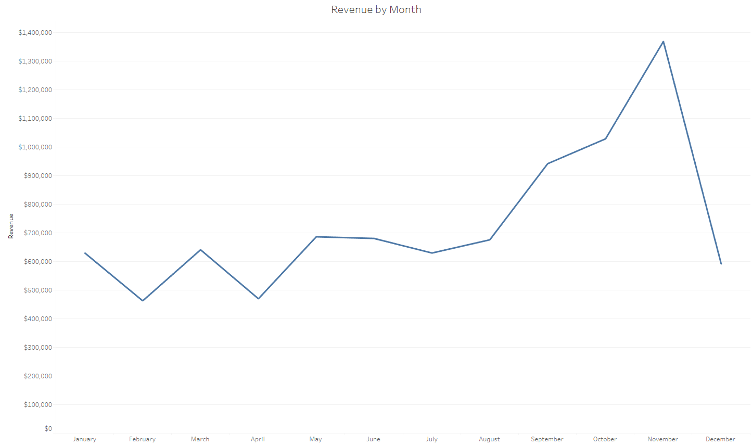
EXPLORATORY ANALYSIS
Here we can see the trend of revenue through the year 2011. August is when the revenue is going a positive direction through November. November is the month with the most revenue generated by the company. There is incomplete data about December to confirm seasonality of revenue.

Slide 6
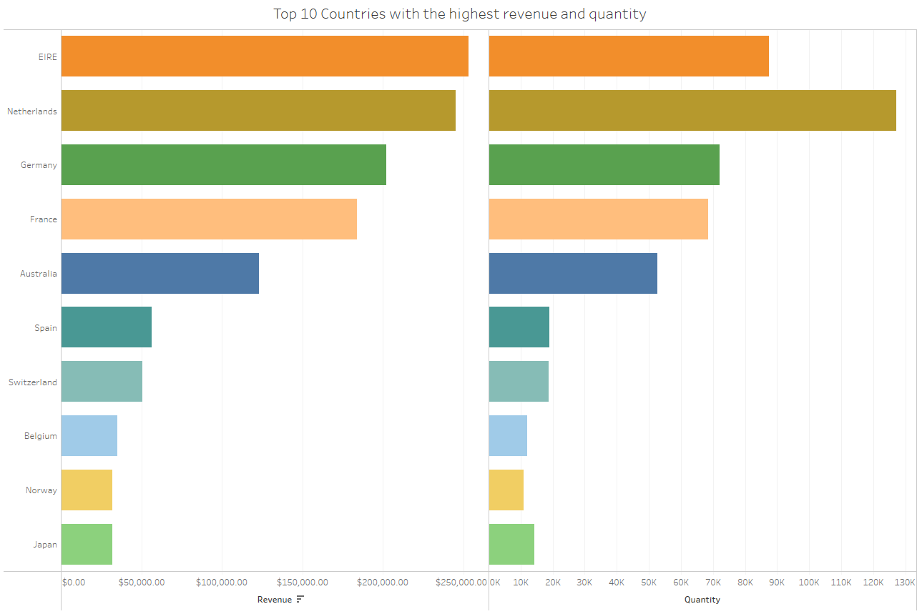
EXPLORATORY ANALYSIS
Ireland is the country that generated the most revenue out of 38 countries followed by Netherlands and Germany. We noticed that even though Ireland is top 1, Netherlands still has the most quantity sold by product. The products sold in Netherlands might be cheaper compared to the ones sold in Ireland.

Slide 7
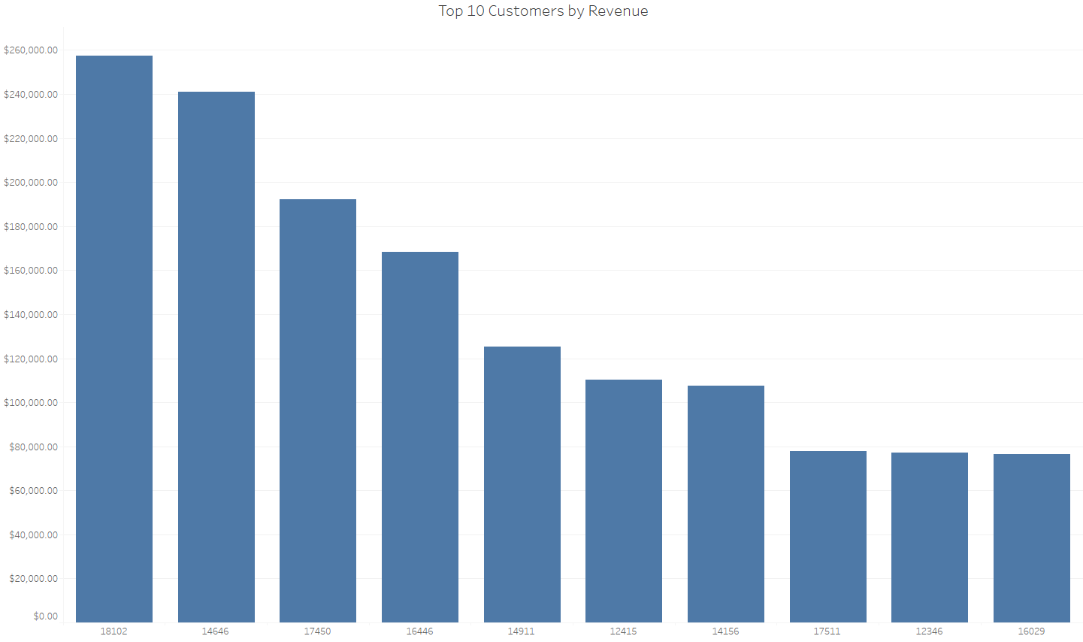
EXPLORATORY ANALYSIS
Here we see the top 10 customers by revenue. The top customer generated about $257,520. There are 2 customers that generated an average of $77,000 and $56,000 in revenue which is customerID 12346 and 16446 respectively.

Slide 8
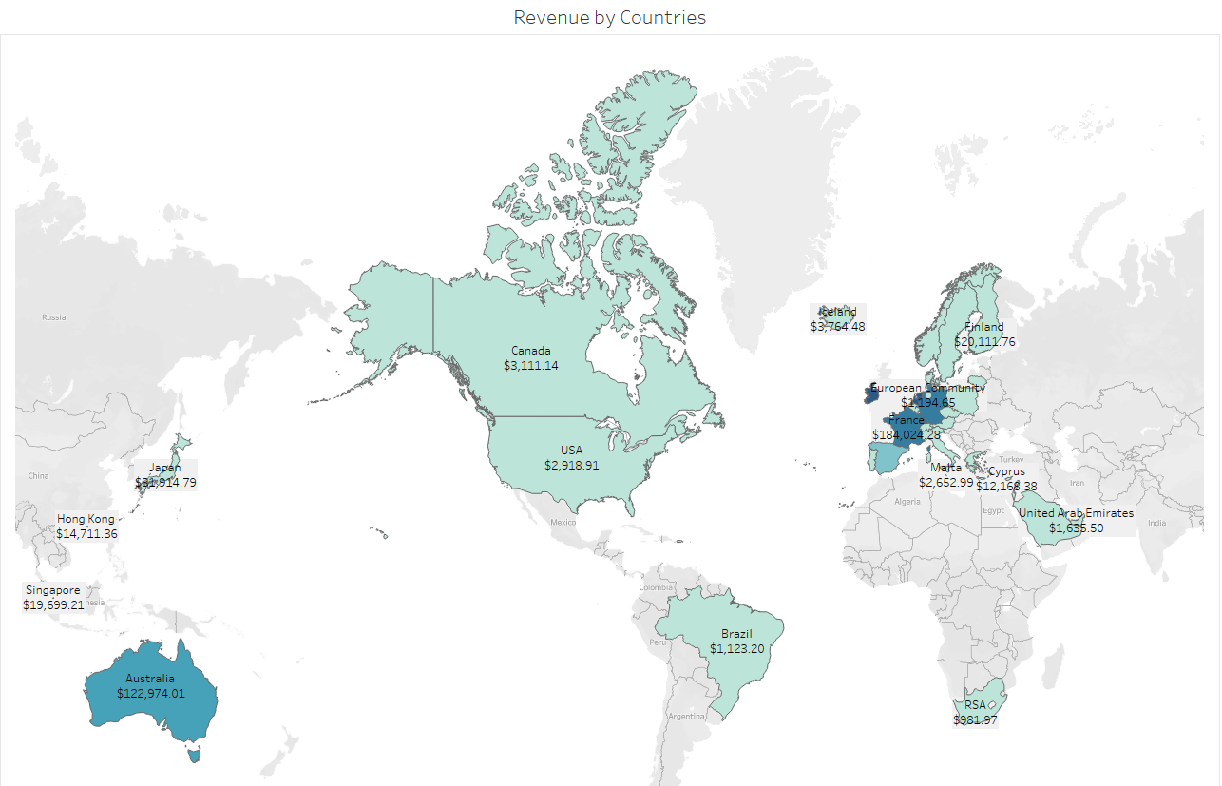
EXPLORATORY ANALYSIS
Ireland is the country that has the highest revenue which makes it the best country for a business expansion. The surrounding areas around Ireland seems promising for the popularity of the business. Countries like Netherlands, Germany and France has a significant customer base that can also be looked at for opportunities.

Slide 9
RECOMMENDATIONS
There is incomplete data in December but it shows a promising month since the –Ber months we can see a steady uptrend of revenue.
Ireland and the surrounding areas has generated great revenue and the company has a significant customer base that we can tap into for expansion opportunities.
The top customers has an average revenue starting with $77,183 then $56,157 then drastically falls from $13,000 to $2,000 range.
Data such as profit can be used in future analysis to evaluate more of the business performance

Slide 10
THANK YOU!

